Slide 1
3.4.1 Project
Alex Canales, Thomas Hughes, Mohsin Siddiqui
(King Moh)

Slide 2
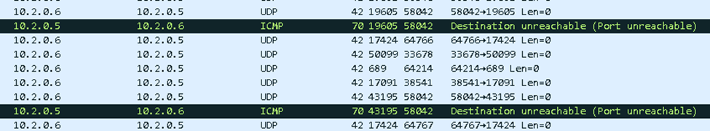
Reports for Part A, B, C
A. Normal Traffic looks like a smooth based network with no errors and nothing too suspicious or repeated going on. No unauthorized sources or destinations. The previous packets in project 3.3.5 with 3 of them normal. We can use Ethernet 2 as a tool to look at because if there is an attack happening, there are certain signs like the arrival time or the frame length.
B. Open a live wireshark capture with a tcp dump. Usually there is a counting basis and a time frame with it. The source and destination must “have a conversation” with each other to find packets and send/receive information. The color of the frame in the packet will usually not correlate with the packet.
C. There does seems to be some problems in the baseline traffic containing some destinations being unreachable. 10.2.0.6 is sending lots of packets of UPD to 10.2.0.5.

Slide 3
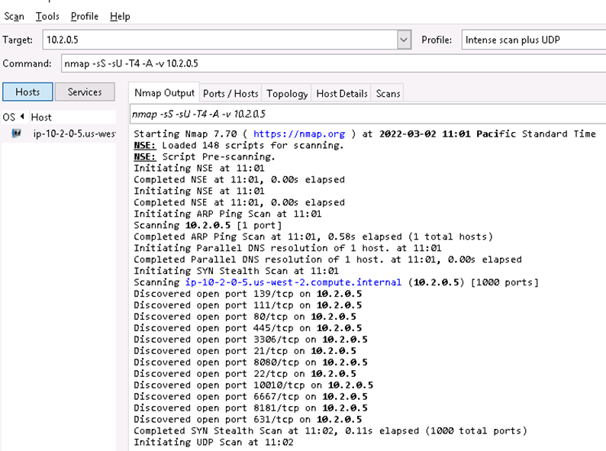
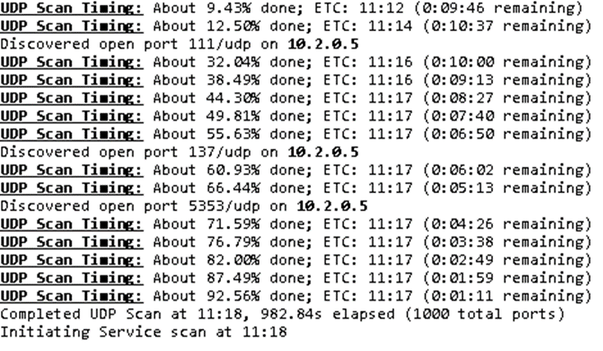
Report for Parts D and E
D. 10.2.0.6 (Pump Monitor) is the attacker, and the victim is 10.2.0.5 (PumpPLC)
E. You can identify it with Zenmap, scanning with Intense scan plus UDP
Port 88, Port 5353, Port 111, and Port 137

Slide 4
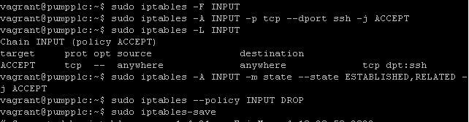
Report for Part F
F. Close Ports in which unwanted traffic can come into the host. Accept any tcp actions and drop/deny any services not wanted, like upd because they are different protocols. You can configure this in powershell and saving the changes.

Slide 5
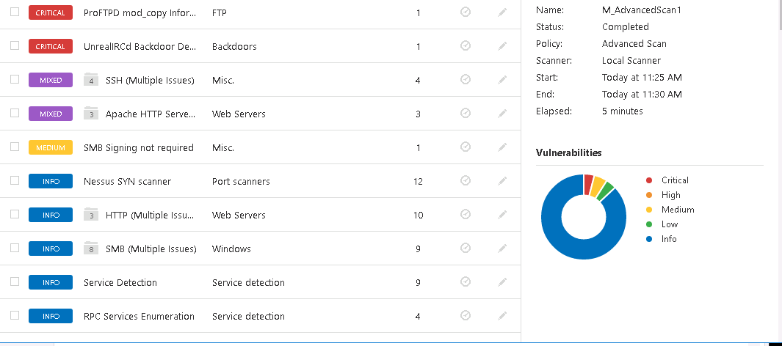
Part G (Part 1)
Strange processes are found on Nessus and a Nessus scan is required to see the processes running on the system and the suspicious process is the Backdoor process that is critical. Going into powershell, you can get on the exploit and identifying the process run by “boba fett” which is connected to the same backdoor process to kill later (Show in Part G Part 2).

Slide 6
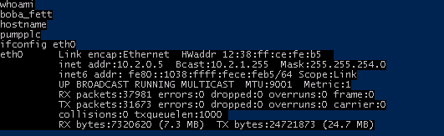
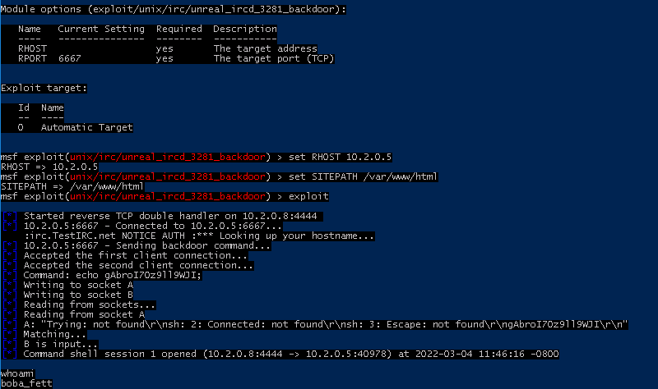
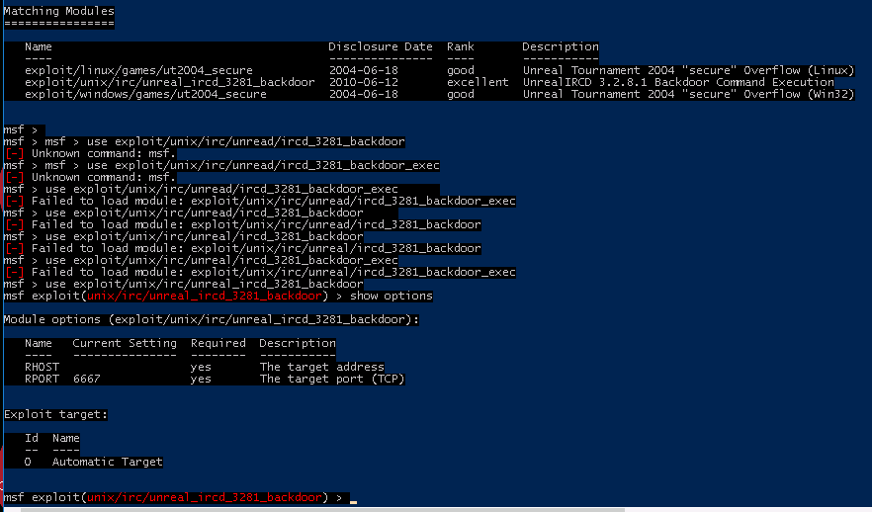
Report for Part G (Part 2)

Slide 7



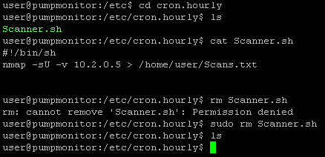
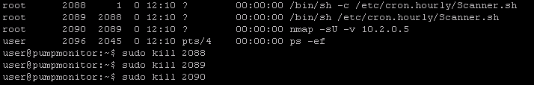
Report for Part H
You can get rid of the unrealircd attack by using the > sudo kill command on the PID associated to boba_fe+ and chewbac+ all done on PumpPLC. On PumpMonitor there are two processes that come back even if you delete them, Scanner.sh and nmap. To stop this you have to navigate to where Scanner.sh is located and use the > sudo rm Scanner.sh command because it is the script that is run hourly and starts nmap.

Slide 8
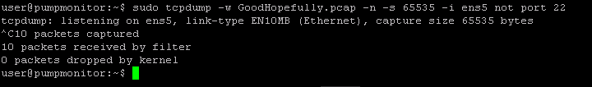
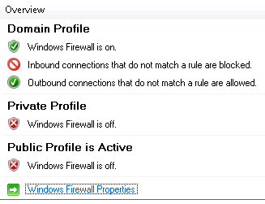
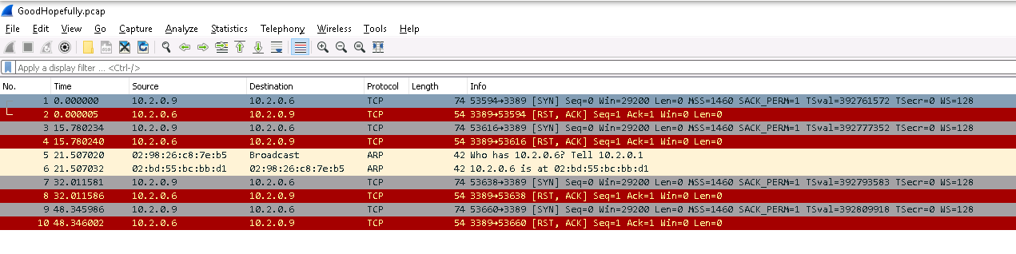


Report for Part I
You need to configure firewalls to not reach the 4 ports that were open. To make sure the processes are killed, new traffic must be generated to make sure no UDP packets are coming in through to the host.
Disable rules for ports 88, 5353, 111, and 137
After the processes were killed, a significant less amount of packets were loaded in by the tcp dump indicating the process was killed and there were no UDP packets were sent to the host.

